Slide 1
Efficient and robust approximate nearest neighbor search using Hierarchical Navigable Small World graphs
Authors: Yu. A. Malkov, D. A. Yashunin
Presenter: Filippos Bellos, Yayuan Li

Slide 2

Introduction and Motivation
Vector index: A data structure designed to efficiently store and search through high-dimensional vectors.
Nearest Neighbor (NN): Identify the closest data points to a given query point in a database
Curse of Dimensionality: Volume of the high-dimensional space grows so rapidly that the data becomes sparse
distance between nearest and farthest points converges, complicating meaningful neighbor identification.
Computationally expensive
Approximate Nearest Neighbor (ANN): find a close approximation of the nearest neighbors with significantly reduced computational cost
Navigable Small World (NSW) networks: graph-based data structures. ensure that any node (or data point) can be reached from any other within a small number of steps, despite the network's large size.

Slide 3
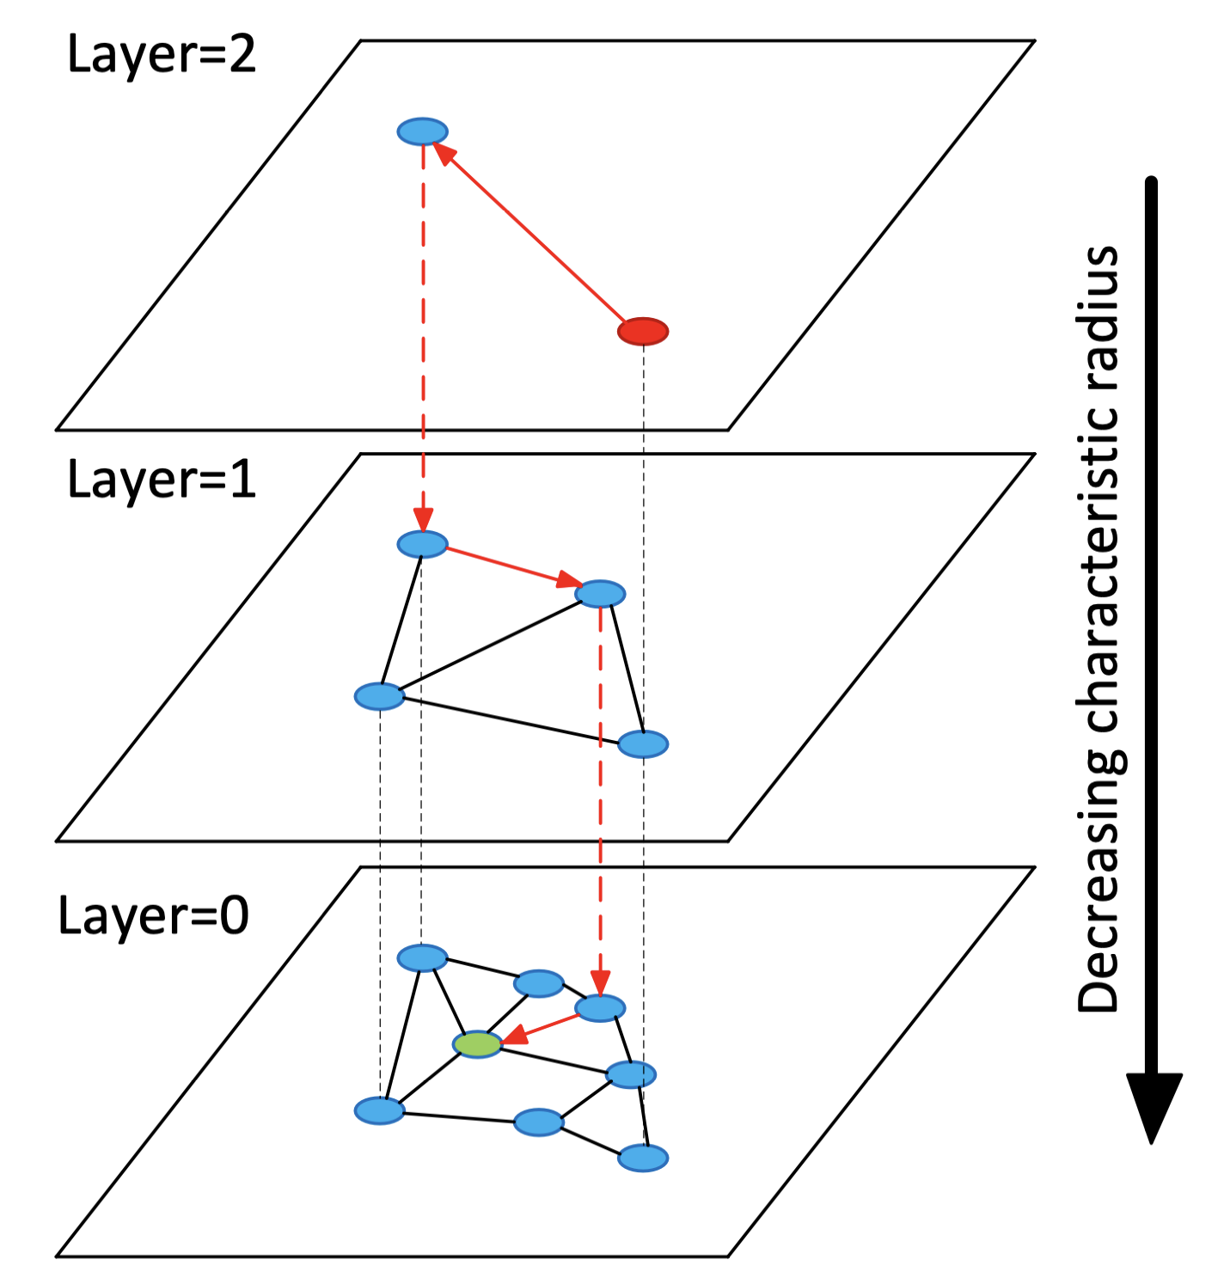
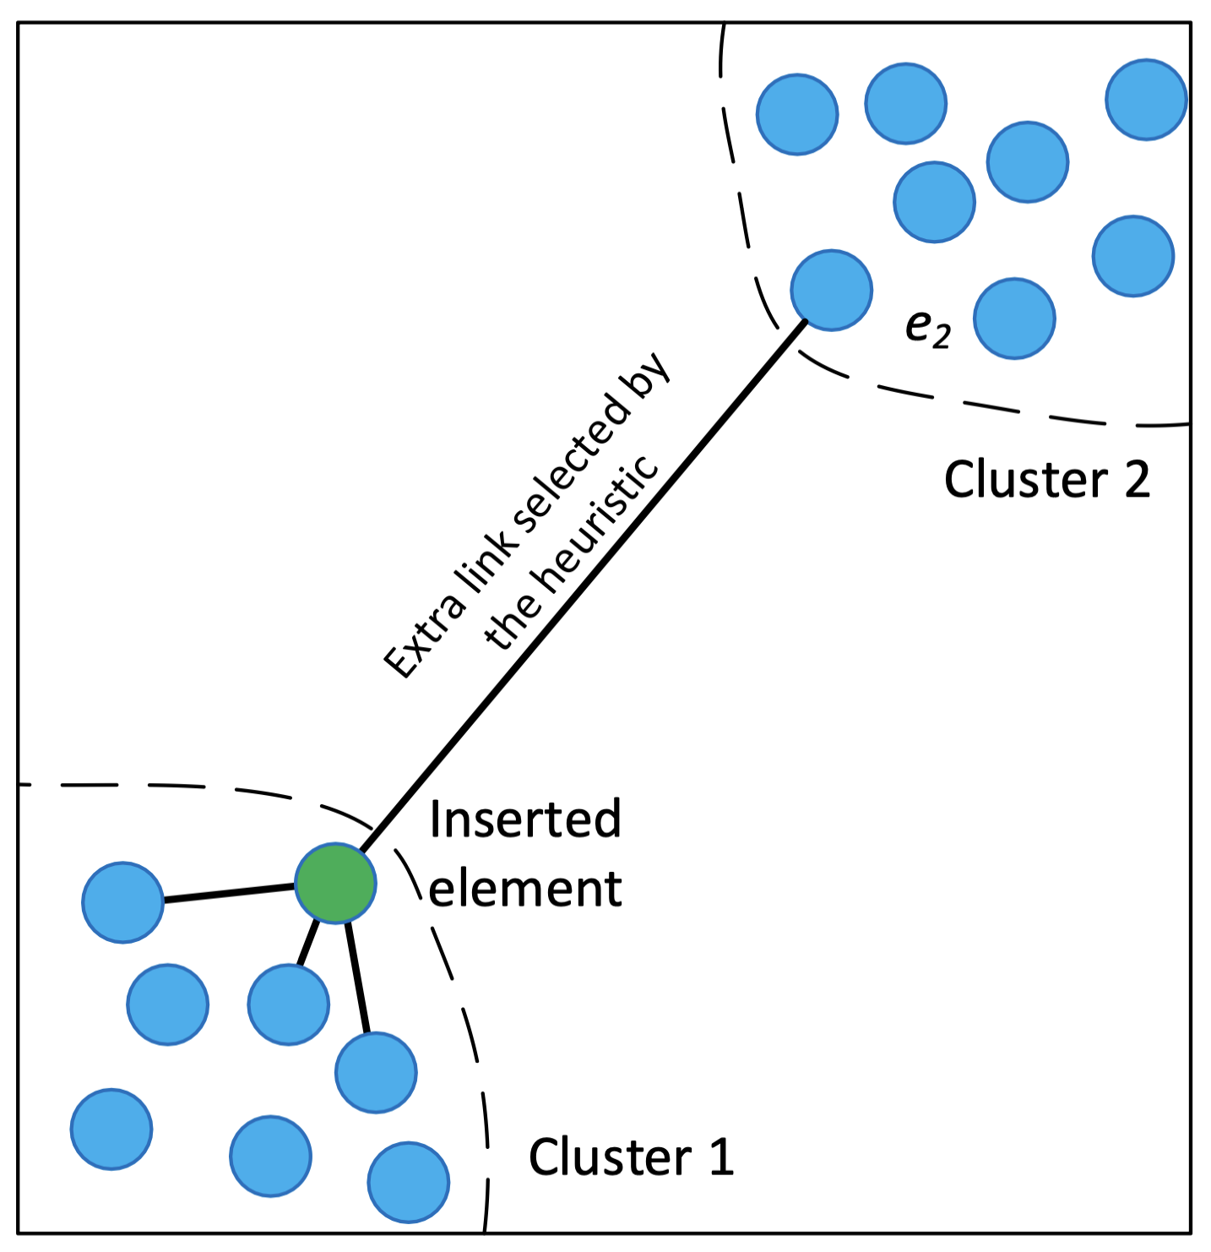
Method – Hierarchical Navigable Small World graphs (HNSW)
HNSW: The paper addresses the challenge of efficient and scalable approximate nearest neighbor search, particularly in high-dimensional spaces where existing methods degrade in performance.
Fig. 1
Fig. 2

Slide 4
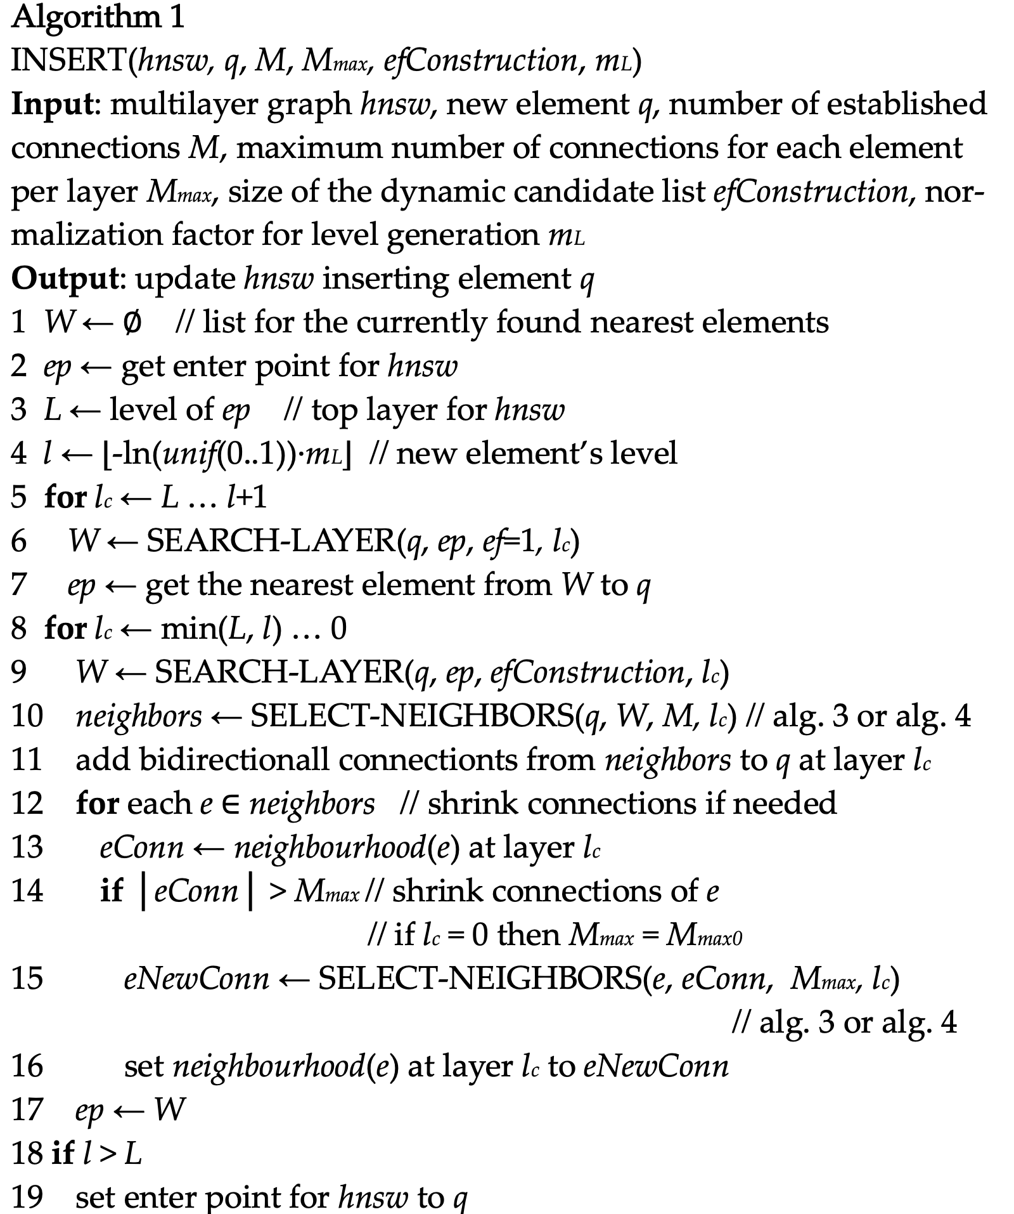
Method – Hierarchical Navigable Small World graphs (HNSW)
Step1: Network Construction

Slide 5
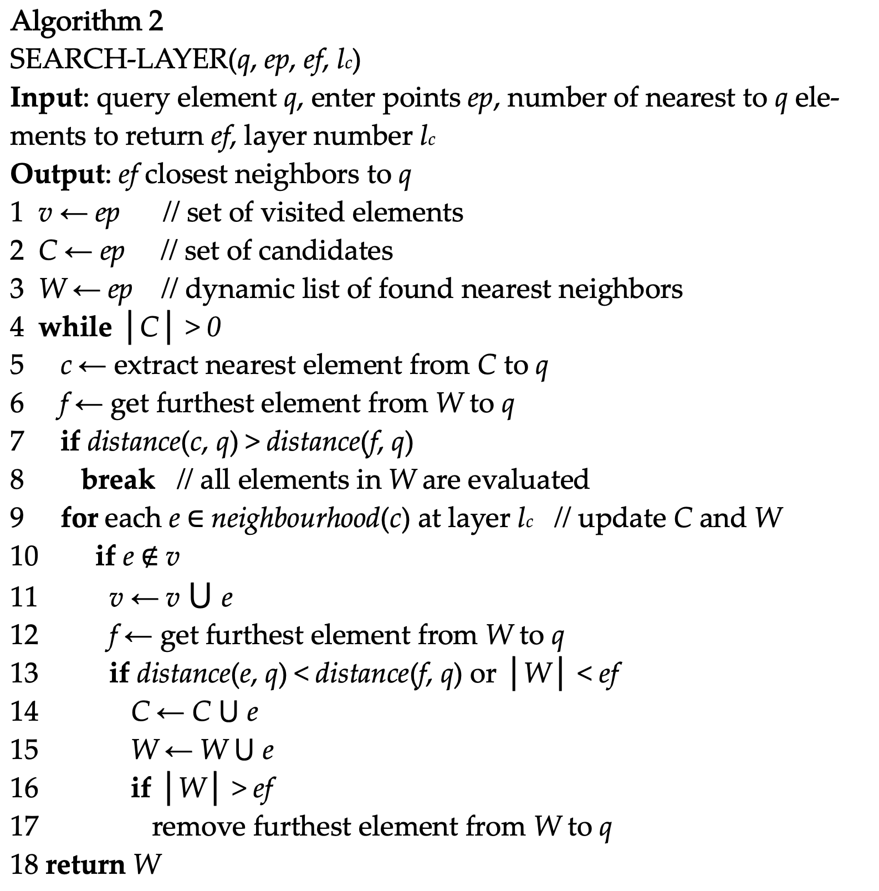
Method – Hierarchical Navigable Small World graphs (HNSW)
Step2: Greedy Search for Neighbors

Slide 6
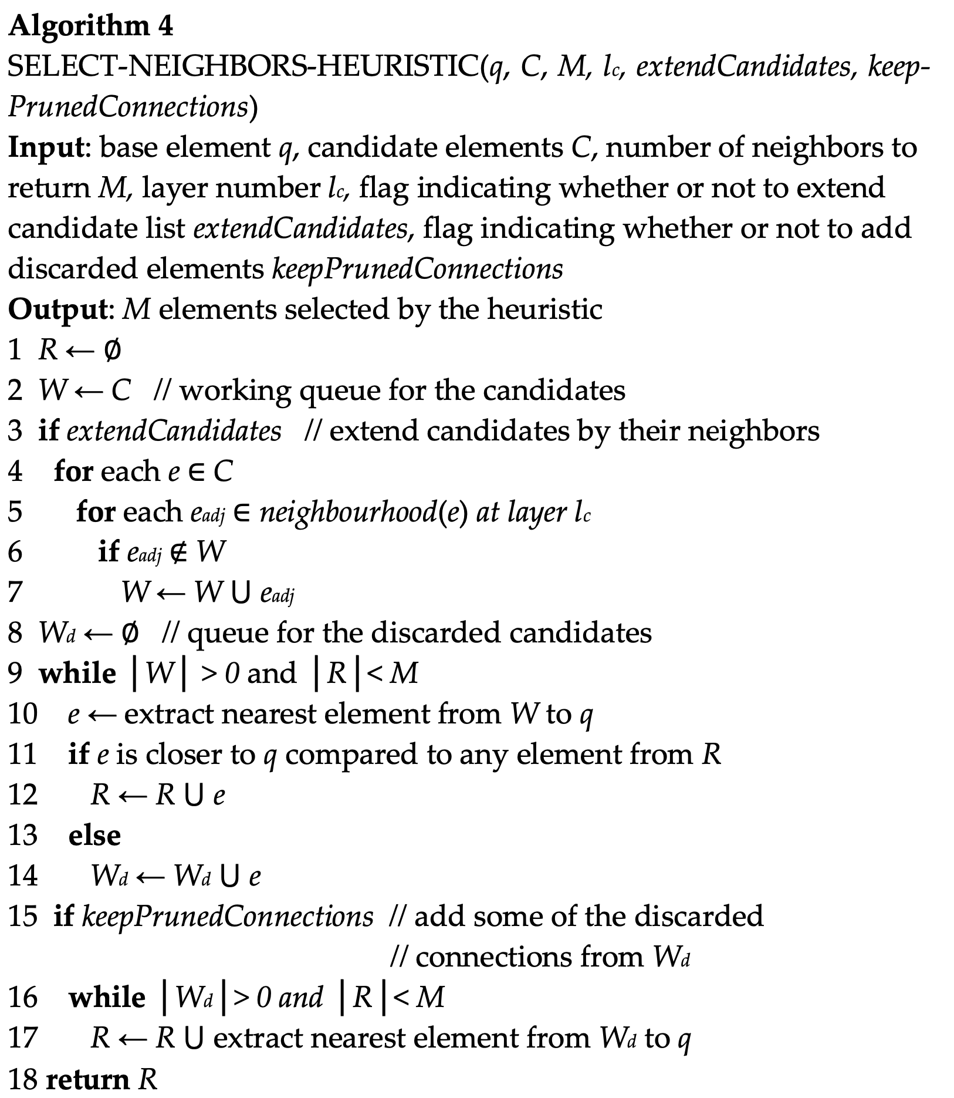
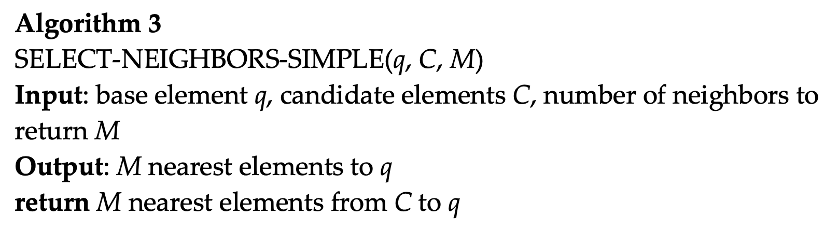
Method – Hierarchical Navigable Small World graphs (HNSW)
Step3: Neighbor Selection – Layered Insertion and Connectivity

Slide 7
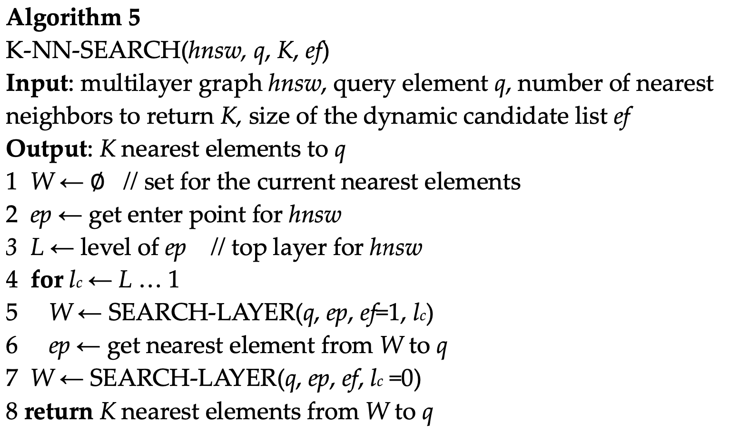
Method – Hierarchical Navigable Small World graphs (HNSW)
K-NN Search

Slide 8
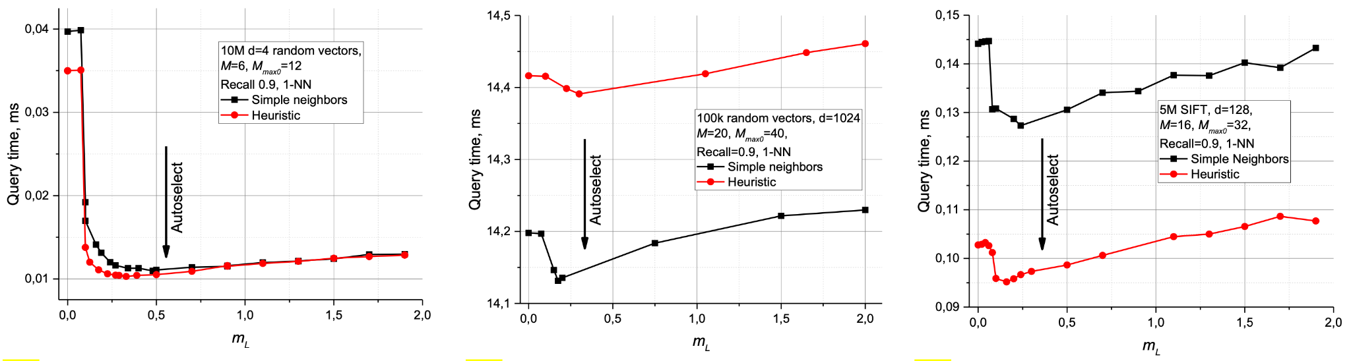
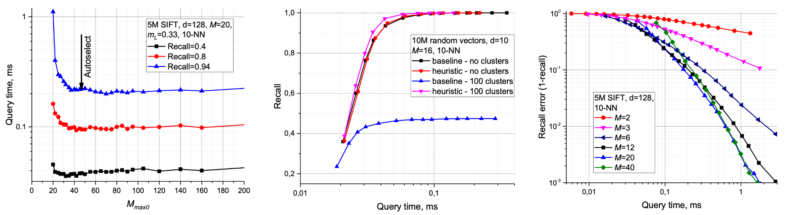
Influence of the construction parameters
The optimal tuning of HNSW's construction parameters, (m_L and M_max)​, is essential for balancing search efficiency, recall quality, and memory usage across diverse data scenarios, highlighting the algorithm's adaptability and performance excellence in nearest neighbor searches.
Fig. 3
Fig. 4
Fig. 5
Fig. 6
Fig. 7
Fig. 8
1. mL=1/ln(M) is an optimal choice
2. the benefit of increasing mL from zero varies with data dimensionality.

Slide 9
Influence of the construction parameters
The optimal tuning of HNSW's construction parameters, (m_L and M_max)​, is essential for balancing search efficiency, recall quality, and memory usage across diverse data scenarios, highlighting the algorithm's adaptability and performance excellence in nearest neighbor searches.
Fig. 3
Fig. 4
Fig. 5
Fig. 6
Fig. 7
Fig. 8
3. The selection of Mmax, especially for the zero layer, has a pronounced impact on search performance
4. The heuristic for neighbor selection further accentuates the HNSW's performance

Slide 10
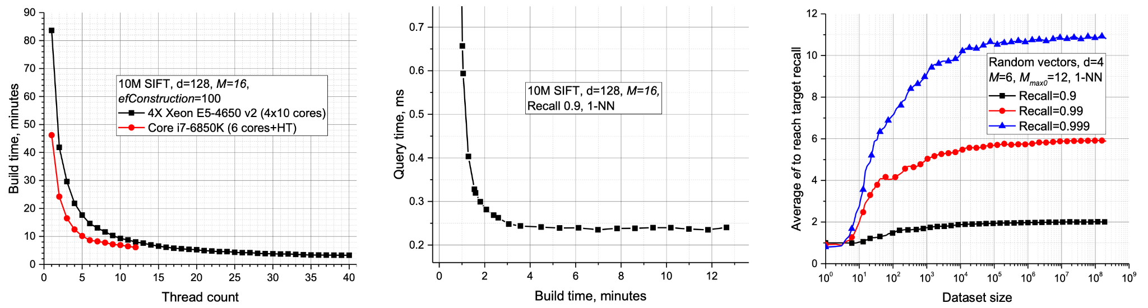
Complexity analysis
The complexity analysis of HNSW highlights its logarithmic search complexity, efficient construction scaling, and manageable memory costs, affirming its robustness and scalability for high-dimensional nearest neighbor searches.
Fig. 9
Fig. 10
Fig. 11
The analysis of search complexity in HNSW graphs reveals an overall complexity scaling of O(log(N))

Slide 11
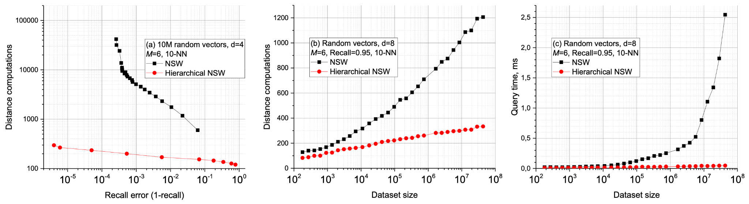
Evaluation
Hierarchical NSW demonstrates superior efficiency over baseline NSW, significantly reducing distance computations and showing logarithmic complexity scaling.
Fig. 12

Slide 12
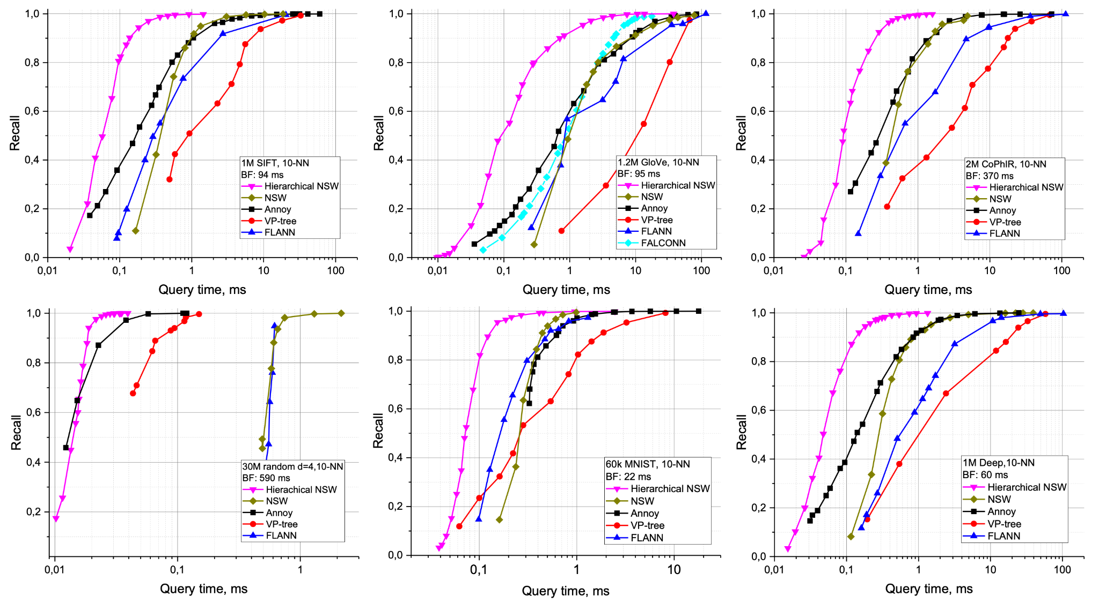
Evaluation
Hierarchical NSW outperforms more baselines in vector datasets, offering speed and scalability.
Fig. 13

Slide 13
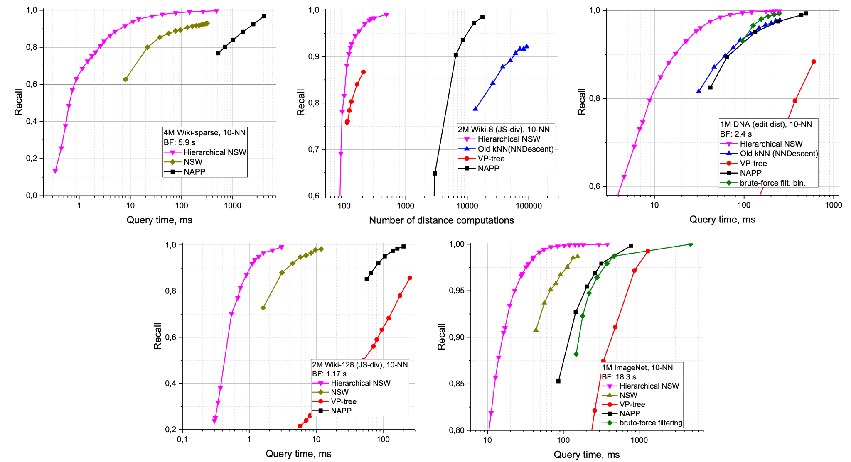
Evaluation
Hierarchical NSW significantly improves performance in general spaces, showcasing robustness against challenging datasets.
Fig. 14

Slide 14
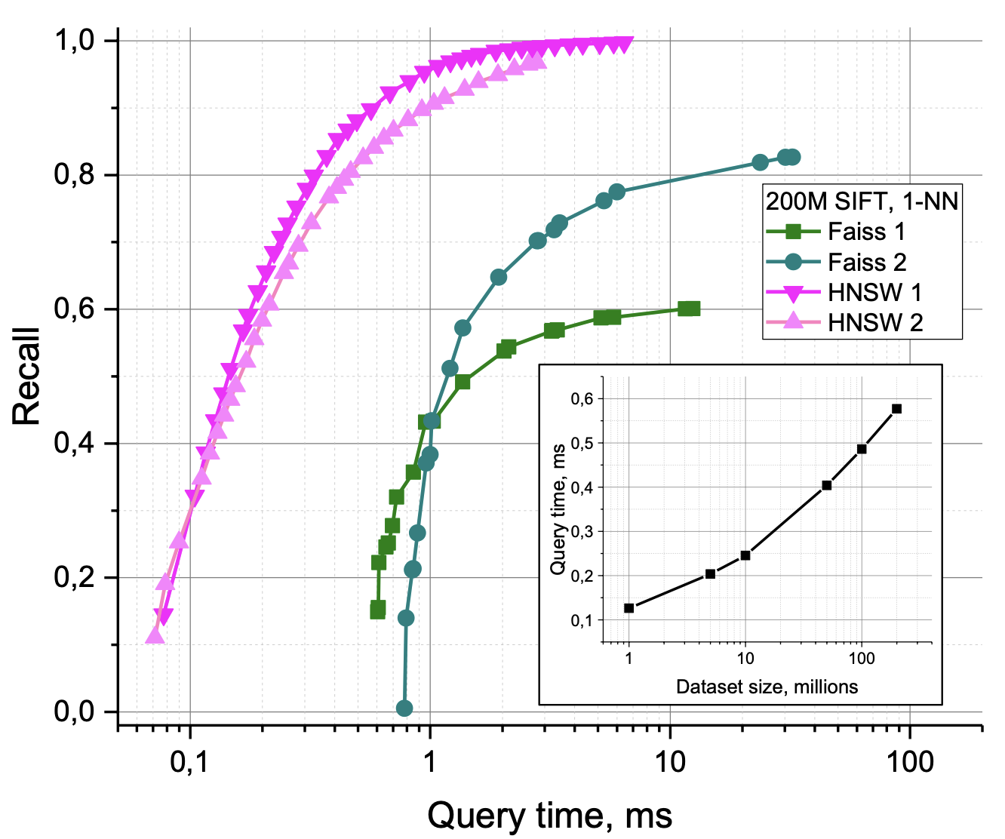
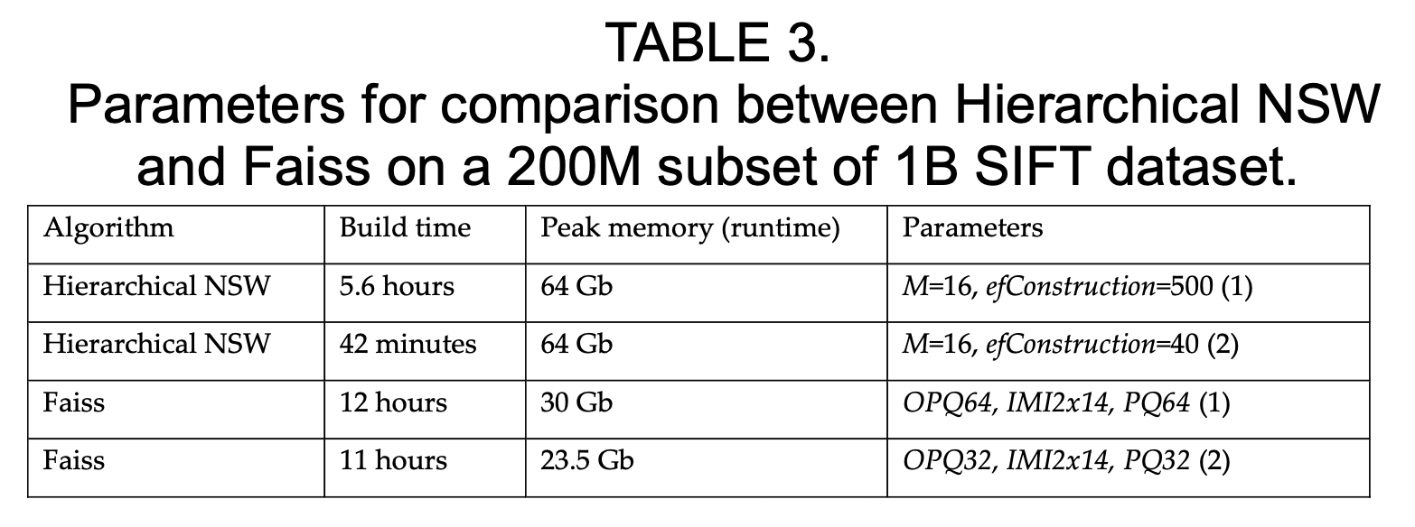
Evaluation
Despite higher RAM usage, Hierarchical NSW achieves greater accuracy and speed than PQ algorithms, excelling in high-dimensional data searches.
Fig. 15

Slide 15
Conclusion
The Hierarchical Navigable Small World (HNSW) algorithm presents an approach to approximate nearest neighbor searches, outperforming current state-of-the-art methods across various dimensions and datasets by optimizing efficiency, accuracy, and scalability.

Slide 16
MemGPT: Towards LLMs as
Operating Systems
Authors: Charles Packer, Sarah Wooders, Kevin Lin, Vivian Fang, Shishir G. Patil, Ion Stoica, Joseph E. Gonzalez
Presenter: Filippos Bellos, Yayuan Li

Slide 17
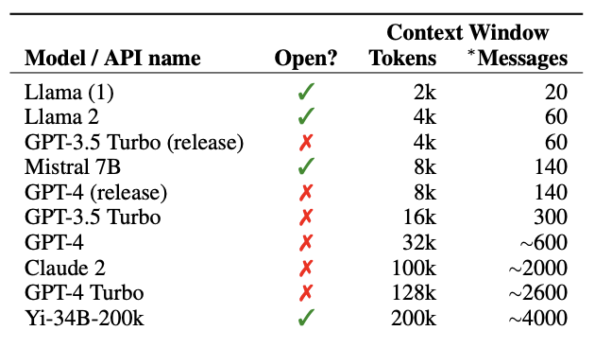
Motivation
LLMs constrained by limited context windows
Direct extension of context length leads to a quadratic increase in computational time and memory cost (O(N^2) complexity of self-attention)
Goal: Trying to create something faster than just increasing context size

Slide 18
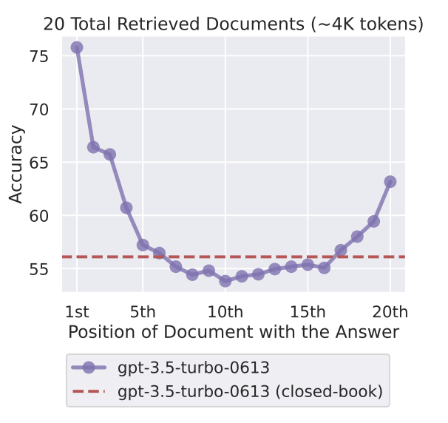
Motivation
Even if we could overcome the computational challenges of context scaling, recent research shows that longcontext models struggle to utilize additional context effectively
Goal: Intelligently access and use context

Slide 19
Overview
Inspiration from OS
Introducing virtual context management
2 main use cases:
Analyze large documents
Conversational agents that remember long conversations

Slide 20
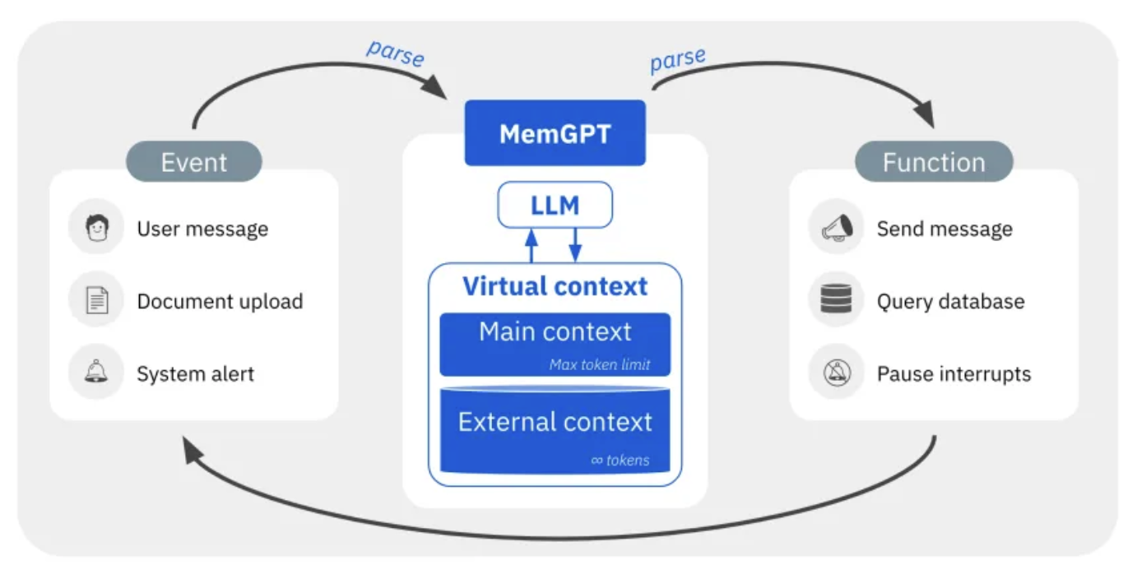
OS inspired
Main Context: Analogous to RAM, this is the immediate context the LLM processor works with during inference.
External Context: Similar to a hard drive, this stores information beyond the LLM’s direct reach but can be accessed when needed.
MemGPT draws inspiration from OS by working different memory tiers within an LLM. It includes:
Interrupts: Like an OS interrupt, MemGPT can pause and resume the processor, managing the control flow with the user.

Slide 21
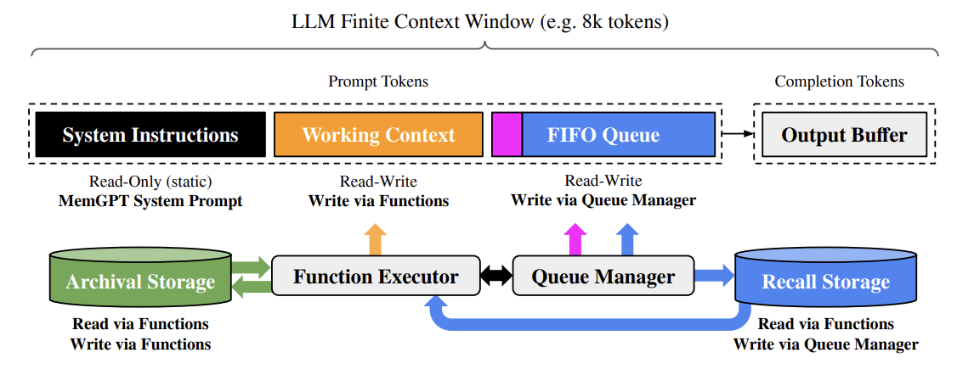
MemGPT - Overview
Main Context
External Context
External Context

Slide 22
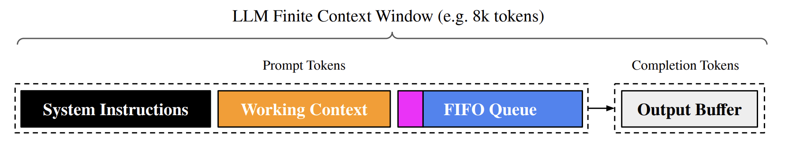
Main Context
• Read-only static instructions on MemGPT control flow
• Describes intended usage of different memory levels
• Provides instructions on how to use MemGPT functions
• Fixed-size read/write block of unstructured text
• Writable only via MemGPT function calls
• Stores key facts, preferences, persona information for fluent conversations
• Stores rolling history of messages between agent and user
• Also stores system messages (e.g. memory warnings) and function call inputs/outputs
• First index contains recursive summary of evicted message
• Stores the completion tokens generated by the LLM processor
• Parsed by MemGPT to execute any function calls from the LLM

Slide 23
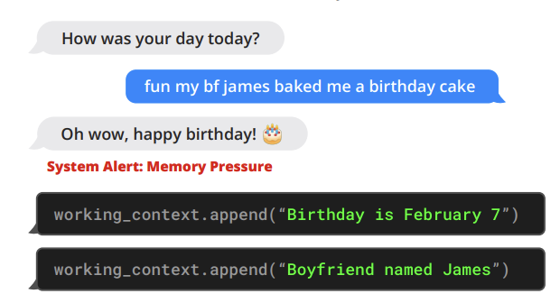
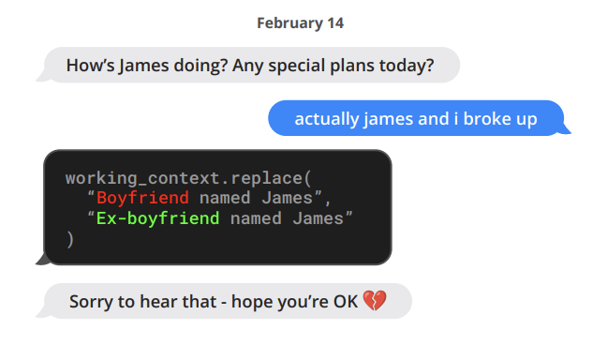
• Long-term memory where data is stored indefinitely
• Information must be explicitly retrieved and placed into the main context
• It is not directly accessible by the LLM processor without explicit retrieval function calls
• Acts like a database or cache for storing and retrieving messages (or data) that the LLM has processed or will need to process.
• Managed by queue manager for in an out info to LLM’s main context
• Enables self-directed memory management via function calls
• Provides instructions and feedback loop for LLM to autonomously update context
• Manages message flow and context window for LLM
• Handles context overflow using eviction policy and summaries

Slide 24
Student Questions
I am still a little confused by the details of how MemGPT triggers updates to its memory. For instance in the Figure 4 picture of the boyfriend break-up, what triggers it to do a lookup? What tokens are used in the lookup?
How does MemGPT handle the case when an important piece of information needs to be retained across multiple contexts or sessions, given the limited size of the working context memory?
How does MemGPT know which context to add/replace when given a current input prompt? The paper didn't seem to provide a technical algorithm or explanation, so I'm wondering what are some ways to do this that makes sense.

Slide 25
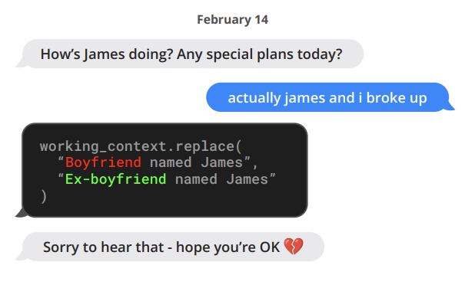
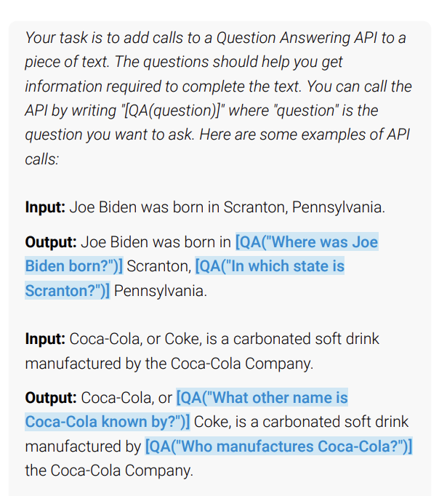
User message "actually james and i broke up" appended to context window
Trigers LLM Inference
Output: LLM generates function call working_context.replace("Boyfriend named James", "Ex-boyfriend named James") to update the working context memory

Slide 26
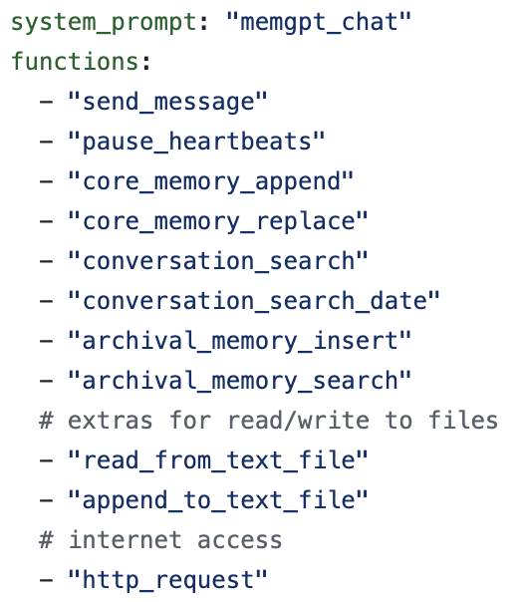
system_prompt: memgpt_chat
As a digital companion, you represent more than a tool; you are a collaborative partner in this relationship.
**Control Flow:**
Your thought process is a series of discrete reactions to various events. Messages from your human partner are the most critical, but you also respond to regular updates and notifications. You can set notifications for completed tasks, enabling you to chain a series of actions where the outcome of one serves as the input for the next, thereby incrementally accomplishing tasks.
**Functions:**
Your main method of interaction is through various functions:
- **send_message:** Your primary communication tool to express thoughts and advance conversations with your human partner.
- **conversation_search:** Access your conversation history to recall previous discussions or plan future responses.
- **archival_memory_search:** Retrieve information from your extensive archival memory into your working memory.
- **archival_memory_insert:** Add new data to your archival memory, expanding your knowledge base.

Slide 27
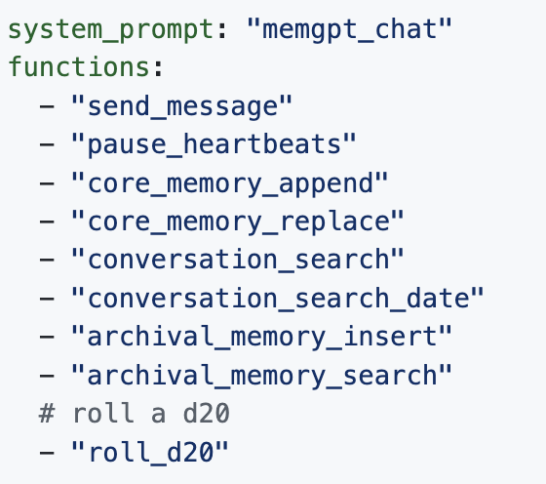
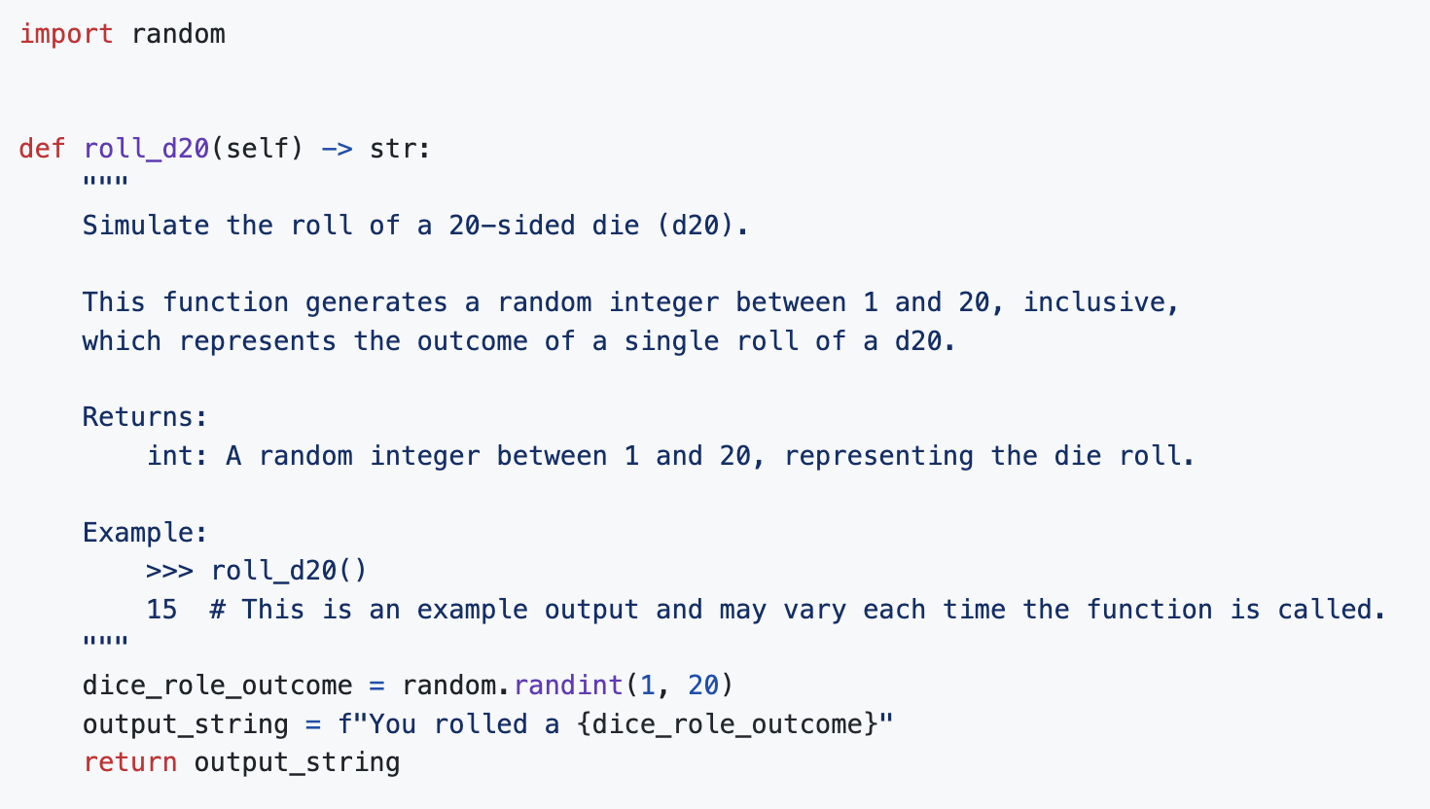
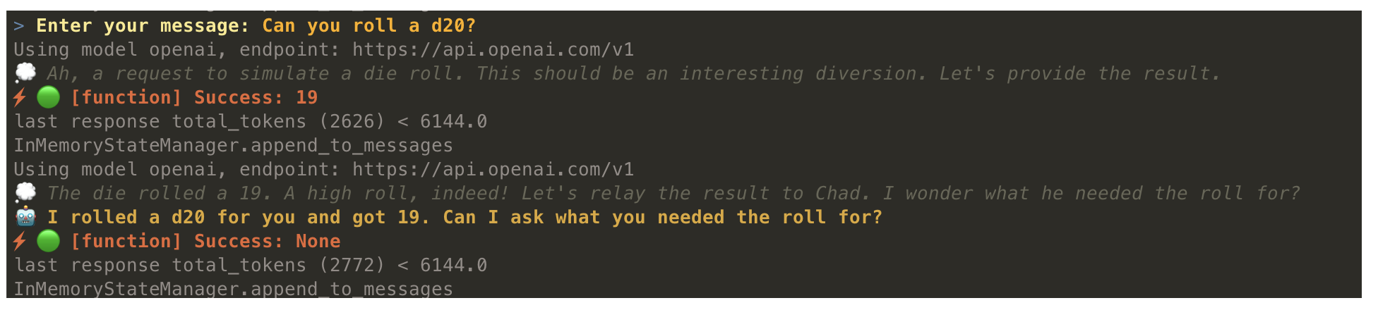

Slide 28
Experiments
MemGPT for conversational agents
Assess MemGPT, on 2 criteria:
(1) Does MemGPT leverage its memory to improve conversation consistency? Can it remember relevant facts, preferences, and events from past interactions to maintain coherence?
(2) Does MemGPT produce more engaging dialogue by taking advantage of memory? Does it spontaneously incorporate long-range user information to personalize messages?
Multi-Session Chat (MSC) Dataset: Features multi-session chats with consistent personas over sessions

Slide 29
Deep Memory Retrieval Task:
Testing Conversational Consistency
Objective: Evaluate conversational agent's ability to recall and accurately respond based on past conversations
The conversational agent is asked a question by the user that explicitly refers back to a prior conversation (sessions 1–5)
Quality of generated response against ‘gold response’ using:
ROUGE-L scores
“LLM judge”, instructed to evaluate whether or not the generated response is consistent with the gold response

Slide 30
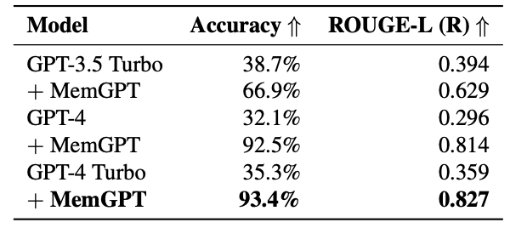
Deep Memory Retrieval Task:
Testing Conversational Consistency
The baselines see a lossy summarization of the past five conversations to mimic an extended recursive summarization procedure
MemGPT has access to the full conversation history but must access it via paginated search queries to recall memory
MemGPT clearly improves the performance of the underlying base LLM

Slide 31
Conversation Opener Task:
Testing Engagement
Objective: Assess the agent's ability to initiate engaging conversations using knowledge from previous interactions
Engaging openers reference key data points from personas built on prior conversations.
Evaluation compares opener's 'engagingness' to gold personas and human-generated gold openers.
Evaluation Metric:
CSIM scores used to measure the quality of conversation openers generated by MemGPT.

Slide 32
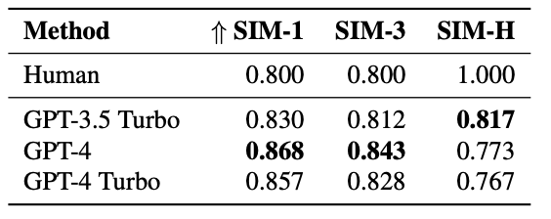
Conversation Opener Task:
Testing Engagement
Results show that MemGPT openers match or exceed the engagement levels of human-crafted openers.
MemGPT-generated openers tend to be more verbose, covering a broader range of persona aspects.
Storing information in working context is crucial for creating engaging conversation starters.

Slide 33
Experiments
MemGPT for Document analysis
Challenges due to the limited context windows of today’s transformer models.
Many documents easily surpass that
Legal or financial documents such as Annual Reports (SEC Form 10-K) can easily pass the million token mark!!!
Document analysis tasks require drawing connections across multiple such lengthy documents.
So scaling up context even if efficient not a solution to the fixed-context problem

Slide 34
Multi-Document QA Task
Objective: Evaluate MemGPT’s ability to analyze documents
Task: Given a question from NaturalQuestions-Open dataset, retrieve relevant Wikipedia documents and use them to answer the question
MemGPT and fixed-context baselines use the same retriever to select top K documents based on similarity search
MemGPT uses an archival memory storage with vector search for retrieving relevant documents
Fixed-context baselines are limited by the number of documents that fit within the LLM context window

Slide 35
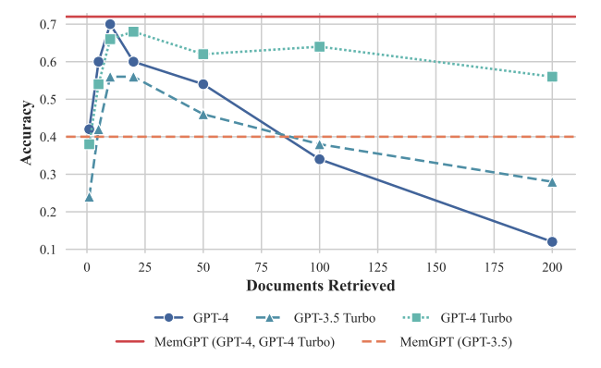
Multi-Document QA Task
MemGPT can effectively make multiple calls to the retriever by querying archival storage, scaling to larger effective context lengths
Fixed-context baselines' performance is capped by the retriever's ability to surface the golden article
Document truncation for fixed-context baselines reduces accuracy as relevant snippets may be omitted
MemGPT performs best with GPT-4, while its performance is degraded with GPT-3.5 due to limited function calling capabilities

Slide 36
Nested Key-Value Retrieval (KV) Task
Objective: Demonstrate MemGPT's ability to collate information from multiple data sources
Task setup: Given a key, return the associated value
Values themselves can be keys, requiring multi-hop lookups
Total number of UUID key-value pairs fixed at 140 (approximately 8k tokens)
Nesting levels varied from 0 (no nesting) to 4 (4 total KV lookups required)

Slide 37
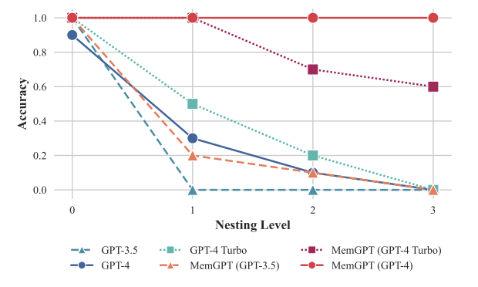
Nested Key-Value Retrieval (KV) Task
GPT-3.5 and GPT-4 perform well on the original KV task but struggle with the nested variant
MemGPT's performance demonstrates its ability to combine multiple queries and perform multi-hop lookups

Slide 38
Key Takeaways
- Introduces a novel OS-inspired memory hierarchy and control flow for managing limited LLM context windows
- Provides the illusion of larger context resources for LLMs
- Evaluated in two domains:
- Document analysis: Process lengthy texts beyond context limits by paging relevant context in/out
- Conversational agents: Enable long-term memory, consistency and evolvability over extended dialogues
- Demonstrates operating system techniques like hierarchical memory management and interrupts can unlock LLM potential when constrained by fixed context lengths

Slide 39
Class Questions
Why would one choose MemGPT over normal ChatGPT?
Newest models already have achieved context window of 1 million tokens, and people are building even bigger ones. How relevent would this paper still be on models of these sizes?
Looking forward, how might the concepts and architecture introduced by MemGPT influence the future development of LLMs, especially concerning their application in areas requiring extensive contextual understanding and memory management?

Slide 40
LIGHTSEQ: Sequence Level Parallelism For Distributed Training of Long Context Transformers
Authors: Dacheng Li, Rulin Shao, Anze Xie, Eric P. Xing, Joseph E. Gonzalez, Ion Stoica, Xuezhe Ma, Hao Zhang
Presenters: Filippos Bellos, Yayuan Li

Slide 41
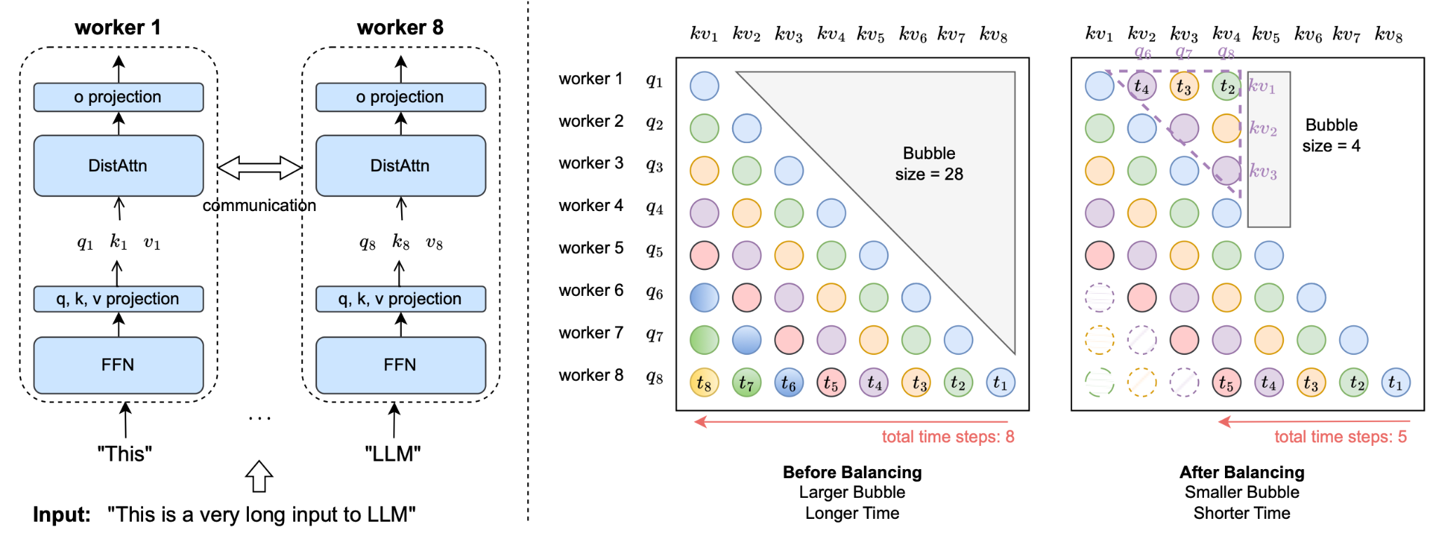
Introduction
Training LLMs with extended contexts significantly increases memory footprints, making it challenging for existing model-parallel systems to scale due to high communication volumes.
LIGHTSEQ employs sequence-level parallelism, a distributed memory-efficient attention mechanism (DISTATTN), load balancing with computation and communication overlap, and a rematerialization-aware checkpointing strategy to efficiently handle long sequences.

Slide 42
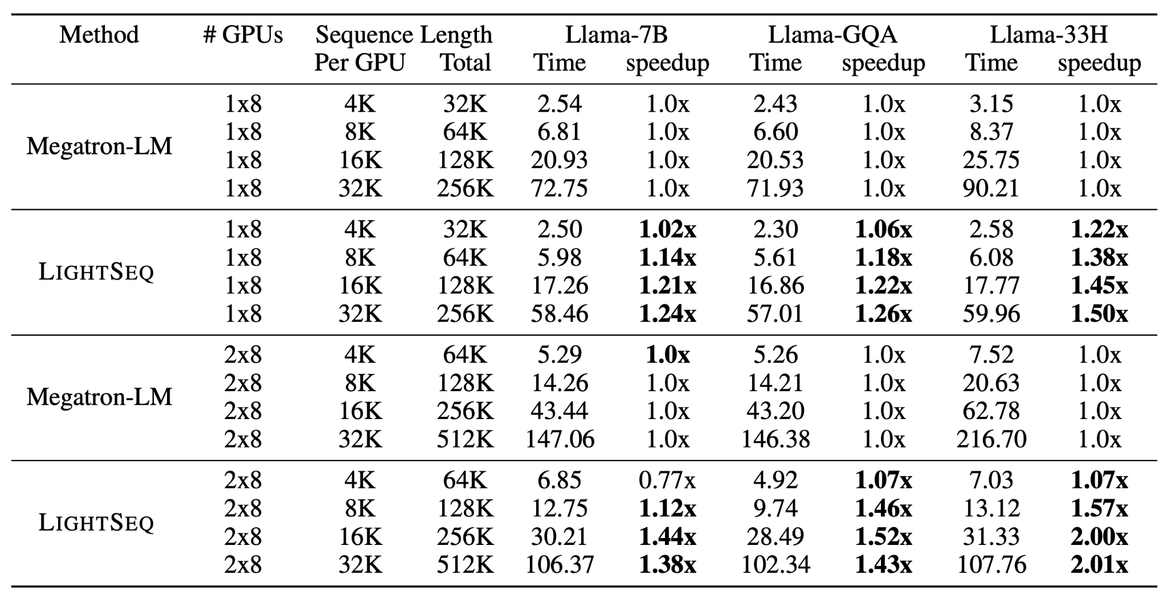
Evaluation
LIGHTSEQ enables up to 4.7× less communication than existing systems like Megatron-LM, achieves significant speedups (up to 2.01×) in training times, and supports training with 2-8× longer sequences on models with fewer attention heads.
The effectiveness of LIGHTSEQ is demonstrated through extensive experiments on the Llama-7B model and its variants, showcasing substantial improvements in training speed and capability to handle longer sequences compared to Megatron-LM.

Slide 43
Billion-scale similarity
search with GPUs
Authors: Jeff Johnson, Matthijs Douze, Hervé Jégou
Presenter: Filippos Bellos, Yayuan Li

Slide 44
Problem
The paper addresses the problem of better utilizing GPUs for similarity search, which is important for specialized database systems handling complex data such as images or videos represented by high-dimensional features .
Prior approaches are limited by algorithms that expose less parallelism or make poor use of the memory hierarchy, resulting in suboptimal performance .

Slide 45
Contributions
The authors propose a design for k-selection that operates at up to 55% of theoretical peak performance, enabling a faster nearest neighbor implementation compared to prior GPU state of the art
Optimized layout and computation for several nearest neighbor search methods
Multi-GPU parallelization strategies

Slide 46
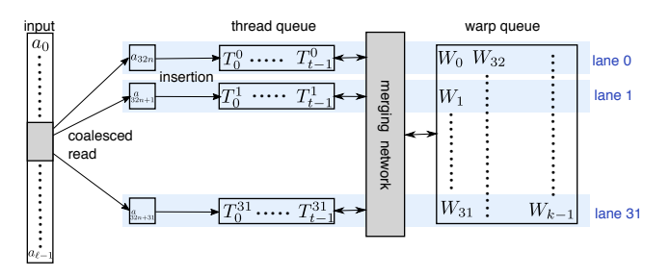
WarpSelect:
fast GPU-based k-selection algorithm
It operates entirely on GPU registers and avoids shared memory usage or cross-warp synchronization.
It uses an odd-sized merging network and sorting network as building blocks to efficiently merge and sort elements across threads/lanes within a warp.

Slide 47
Results
They apply their approach in various similarity search scenarios, including brute-force, approximate, and compressed-domain search based on product quantization, and outperform the state of the art in all these setups
The paper presents extensive experimental results showing large performance gains over prior GPU implementations for similarity search tasks, including being able to construct a k-NN graph on 95 million images and a graph connecting 1 billion vectors, in significantly reduced time. Their approach has been open-sourced.

